Slide 1
1次元鎖構造に基づく繰り込み法を用いた 大規模ヘテロ構造ペロブスカイト物質の X線光電子角度分光計算
Shin Yasuda^{A}, Mariko Terao-Dunseath^{B}, Kevin Dunseath^{B}, Philippe Schieffer^{B},
Didier Sébilleau^{B}, Sylvain Tricot^{B}, Keisuke Hatada^{A}
^{A}Dept. of Phys., Univ. of Toyama,
^{B}Dept. of Nanomaterial, Univ. of Rennes
Notes:
紹介に預かりました、富山大学の安田新です。今回はこのようなタイトルで発表をします。
I have to change the logo to newSHin YAsuda dake

Slide 2
Perovskite material: Strontium Titanate (SrTiO₃)
SrTiO₃ unit cell
In substrate, it has:
Ferroelectric phase transition at room temperature [1]
Sr
Sr
Ti
Ti
O
O
Polarization
3,905 Å
Small structural changes are responsible for essential properties.
To understand and/or control these properties, we need:
✓ Surface sensitivity
[1] Haeni, J. H., et al., Nature. 430 7001 (2004).
Notes:
まず本研究の対象物質について簡単に紹介します。
対象物質は、ペロブスカイトの一種であるチタン酸ストロンチウムです。
チタン酸ストロンチウムは、ストロンチウム原子、チタン原子、酸素原子からなり、常温では左の図の立方晶の単位格子を取ります。
物性の一つとして、基盤上で薄膜にした際に、常温で強誘電体へ転移することが挙げられます。これはTi原子のオフセットによって起きる自発分極が原因であると考えられている（XAS）。
このように、表面の微細な構造の変化が物性を変化させることがわかっていますが、サブÅスケールの構造変化を捉える、制御するためには、表面敏感な解析手法が有望であると考えられている。
Ti原子の変位、実験的観測：
強調版 日本語訳
ペロブスカイト構造結晶のX線Ti K吸収スペクトルにおける**プレエッジ微細構造（PEFS）**について、完全な解釈を提案する。本解釈は、修正版のフル多重散乱法を用いた多数の計算結果に基づいており、この方法により3d遷移金属酸化物に対する理論スペクトルが実験と良い一致を示すことが確認されている。
特に、中央のピークBはp–d混成効果によって生じ、その強度の大きさはペロブスカイト結晶の強誘電性の分光学的指標と考えられる。そして重要なのは、ピークBの面積が格子定数とTi原子の変位量（配位多面体の瞬間的な中心からの平均二乗変位）で直接的に表されるという点である。すなわち、Ti原子のわずかな変位が、分光学的に強誘電性の有無を決定する主要因となる。熱振動で平均化されたピークBの面積は、三体原子分布関数によって決まる。
一方、長波長側のピークAは主に四重極遷移に由来し、短波長側のピークCはTi 1s電子が隣接する遷移金属原子の空の3d状態へ遷移することに由来する。また、短波長側に追加ピークが現れる場合があり、これはZrのような4d原子がTi原子の周囲の酸素八面体に存在する場合に対応し、その面積は近傍4d原子数で決まる。
DyScO3: スカンジウム酸ジスプロシウム
BO3型のペロブスカイト構造と呼ばれる対称性の高い構造をとる。
タイトル、６０
化学
仮数、
polar discontinuity
alternately charged planes [LaO]+and[AlO2]−
AttheTiO2/LaO-terminated LAO/STO interface,therefore, each interfacial La transfers half of an electron intothe neighboring and formally neutral TiO2layer that decreasesthe oxidation state of interfacial Ti
All epitaxially grown perovskite heterostructures containintrinsic oxygen vacancies and substitutional cations near theinterfaces [14,15]. Interfacial defects may induce additionalcharged carriers
So as in the topic.
We are interested in the perovskites esp, Strontium Titanium Oxygen, or STO, because small changes in its structure are responsible for essential properties.
And it is of great technological importance.
The unit cell is a face-centred one, where we have 8 Srs at each vortex, 6 Oxygen at each centre of the faces and 1 Titanium in the centre.
Here is an example of 2-dimensional electron gas formation.
Firstly, on the left we have the iron and the STO layer and interface.
Secondly, oxygen migrates to the iron layer and we have oxidised irons and oxygen vacancies.
And if you look at the unit cell on the right, we have an oxygen vacancy and it causes the titanium to deviate upwards.
However, to understand and control such a property we need accurate crystallographic information, chemical resolution and surface sensitivity and the best way to do that is with X-ray photoelectron diffraction, called XPD.

Slide 3
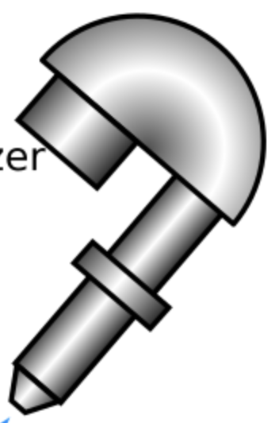
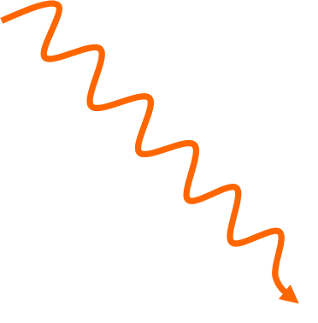



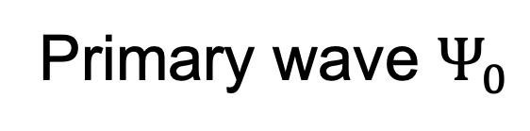
Principle of Photo Electron Diffraction
$$φ$$
X-ray
$$θ$$
$$e^{−}$$
Detector
Surface
Kinetic energy
photoelectron
0
E_{vacuum}
BV
Primary wave $Ψ_{0}$
3s
2p
2s
1s
Binding energy
We aim to extract the structural information through comparison to theoretical results.
Framework: Multiple scattering theory
Notes:
続いて光電子回折分光について説明します。
物質にX線を照射すると、内部の原子軌道から光電子が飛び出し、周囲の原子との相互作用によって散乱されます。散乱後表面から出てきた光電子は検出機で観測されます。
この時、表面に垂直な法線からの傾きシータと、方位角で検出器を動かすことで、光電子強度の角度分布、スペクトルが得られます。
このようにして得られた実験スペクトルに対して本研究では、多重散乱理論を用いた解析を行いました。
Detector
We need to understand the principle of XPD.
When the sample is rotated along the normal to the surface, we talk about an azimuthal spectrum and otherwise of a polar spectrum.
In the following, we will only deal with polar spectra.
Didier: The photoelectron gathers crystallographic information by repeated scatterings with atoms along its way out.

Slide 4
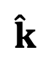

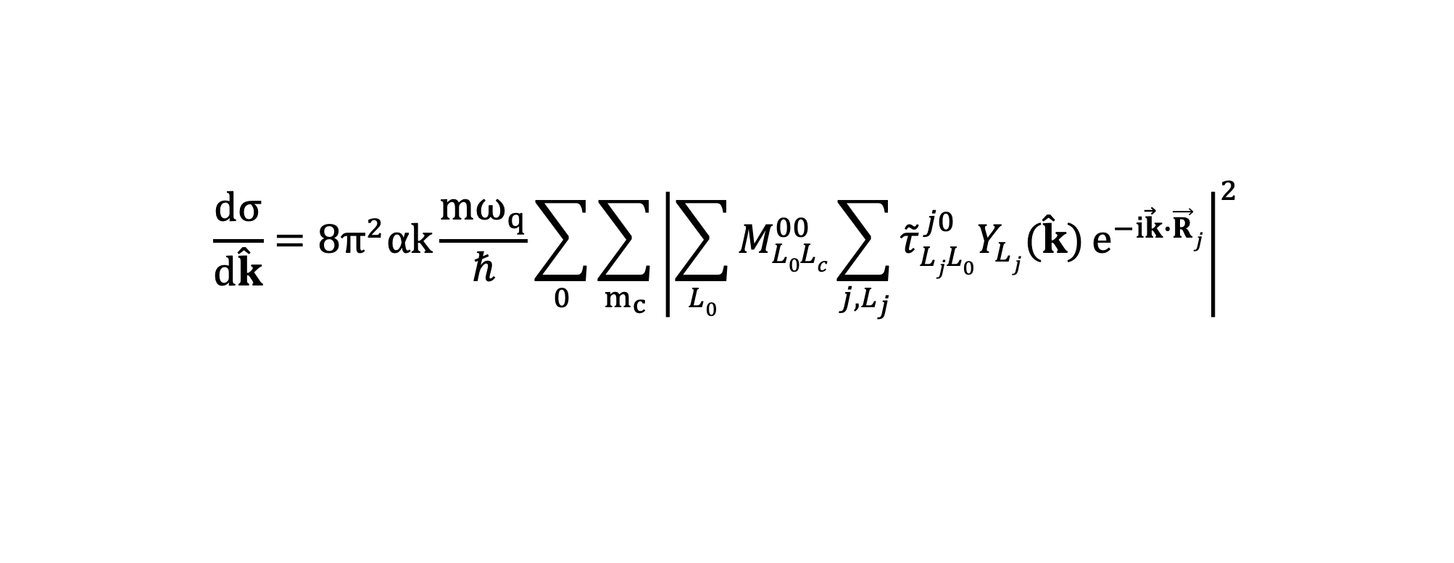

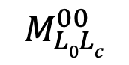
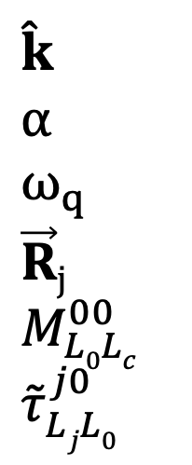
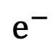
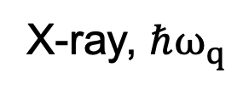
Cross section of Photo Electron Diffraction
Angular dependence of the photoelectron cross section is written:
$$\frac{dσ}{d\hat{k}}=8π^{2}αk\frac{mω_{q}}{ℏ}\sum_{0}{\sum_{m_{c}}{{\left|\sum_{L0}{M_{L0Lc}^{00}{\sum_{j,L_{j}}{{\tilde{τ}}_{LjL0}^{j0}Y_{Lj}(\hat{k})}e}^{−i\vec{k}∙\vec{R}j}}\right|}^{2}}}$$
$$\hat{k}$$
$$α$$
$$ω_{q}$$ $\vec{R}j$
$M_{L0Lc}^{00}$
${\tilde{τ}}_{LjL0}^{j0}$
: direction of a scattered photoelectron
: fine structure constant
: frequency of an incoming photon
: position of the atom j
: coupling matrix describing excitation of a photoelectron
: scattering path operator for the atoms 0 and j
X-ray, $ℏω_{q}$
$$e^{−}$$
$$M_{L0Lc}^{00}$$
$${\tilde{τ}}_{LjL0}^{j0}$$
$$\hat{k}$$
j
j
0
First step
0
Second step
0
$$e^{−}$$
excitation
Notes:
多重散乱理論について解説します。
この式は、kの方向に散乱された光電子強度を表す式であり、Fermiの黄金律を用いて導出されます。
図で示すと、。。
多重散乱における光電子の散乱の情報はこのτにあるので、これの計算方法についてもう詳しく見ていきます。
polar discontinuity
alternately charged planes [LaO]+and[AlO2]−
AttheTiO2/LaO-terminated LAO/STO interface,therefore, each interfacial La transfers half of an electron intothe neighboring and formally neutral TiO2layer that decreasesthe oxidation state of interfacial Ti
All epitaxially grown perovskite heterostructures containintrinsic oxygen vacancies and substitutional cations near theinterfaces [14,15]. Interfacial defects may induce additionalcharged carriers
So as in the topic.
We are interested in the perovskites esp, Strontium Titanium Oxygen, or STO, because small changes in its structure are responsible for essential properties.
And it is of great technological importance.
The unit cell is a face-centred one, where we have 8 Srs at each vortex, 6 Oxygen at each centre of the faces and 1 Titanium in the centre.
Here is an example of 2-dimensional electron gas formation.
Firstly, on the left we have the iron and the STO layer and interface.
Secondly, oxygen migrates to the iron layer and we have oxidised irons and oxygen vacancies.
And if you look at the unit cell on the right, we have an oxygen vacancy and it causes the titanium to deviate upwards.
However, to understand and control such a property we need accurate crystallographic information, chemical resolution and surface sensitivity and the best way to do that is with X-ray photoelectron diffraction, called XPD.

Slide 5
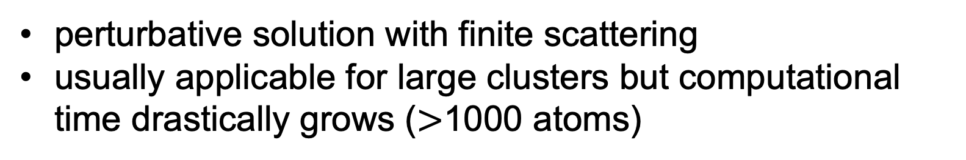
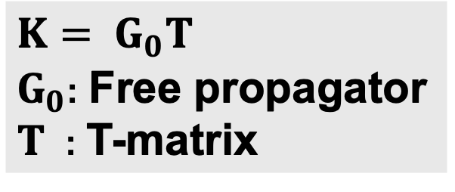

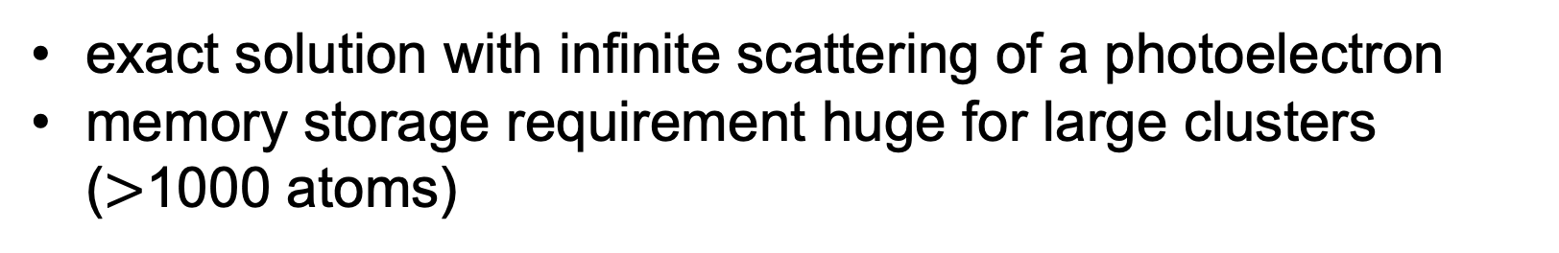


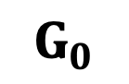
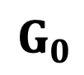
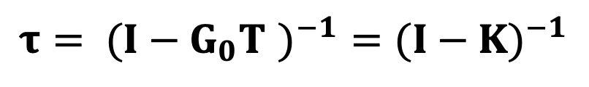
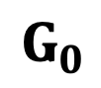
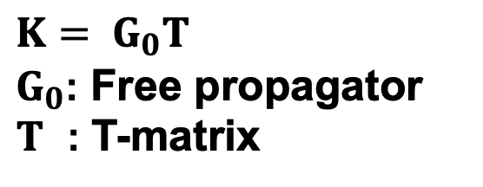
Multiple Scattering Theory
Matrix Inversion
$$G_{0}$$
$$K= G_{0}T$$
$G_{0}$: Free propagator
$T$ : T-matrix
$$τ= ({I−G_{0}T )}^{−1}=({I−K)}^{−1}$$
$$T$$
exact solution with infinite scattering of a photoelectron
memory storage requirement huge for large clusters ($>$1000 atoms)
$$G_{0}$$
$$T$$
$$G_{0}$$
Series Expansion
$$K= G_{0}T$$
$G_{0}$: Free propagator
$T$ : T-matrix
$τ=({I−K)}^{−1}≈I+{K+K}^{2}+…K^{n}$ (n: scattering order)
perturbative solution with finite scattering
usually applicable for large clusters but computational time drastically grows ($>$1000 atoms)
The series expansion shows good agreement with experiments for monoatomic clusters.
Notes:
Τの計算方法について説明します。方法は２つあります。
１つ目は逆行列法です。τ行列はこのように表せます。ここでGとTはそれぞれ原子間の光電子の伝播、原子での光電子の散乱を表す行列です。
図で説明すると、、、光電子はエミッターから出て周囲の原子と無限回散乱を起こします。逆行列法はこの、光電子の無限回散乱を記述しており、理論的に正確です。しかし、扱う原子数が大きくなると計算コストが原子数の３じょうでスケールします。
２つ目は逆行列法の近似手法で、級数展開法です。これは、τの式をテイラー展開のように展開します。ここnは光電子の散乱回数に対応します。
級数展開法は扱う原子数が多くても計算が可能な方法であり、よく使われています。先行研究では、単一原子のクラスターで級数展開法は実験スペクトルをよく再現することに成功しています。
タウを求める方法 N^3
Going further, it is valuable to compare experimental and simulation results.
The first reason is that all the information we seek is in the spectrum, but we have no direct way to retrieve it.
And this information can only be accurately extracted by comparison with a theoretical model, which is in the framework of multiscattering theory.

Slide 6
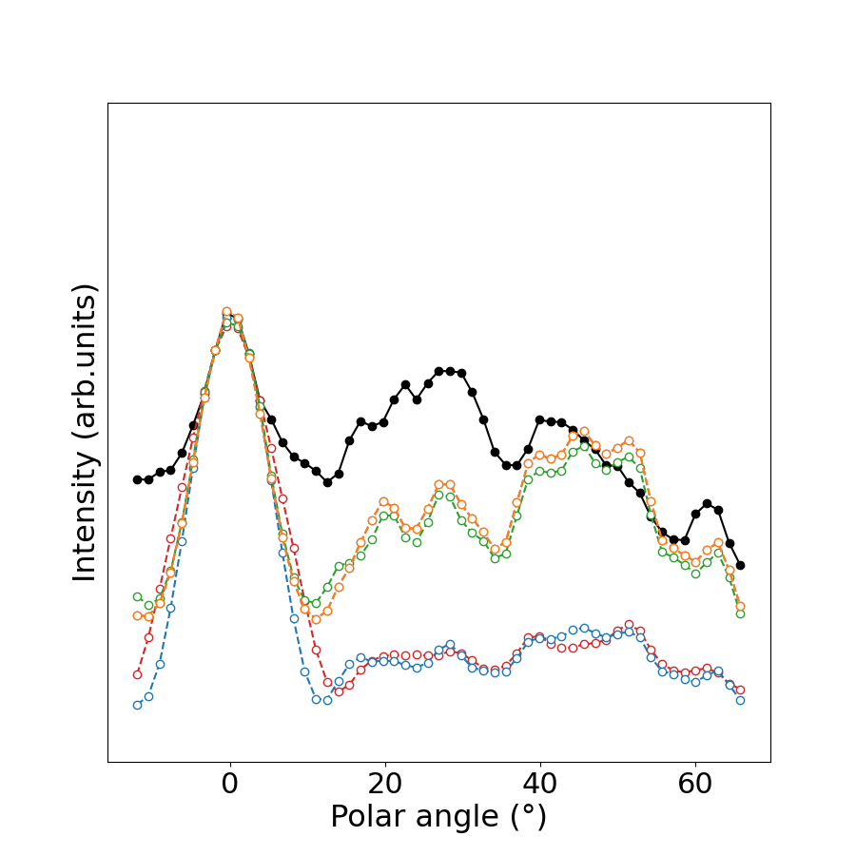
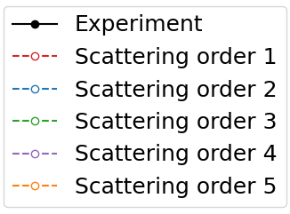
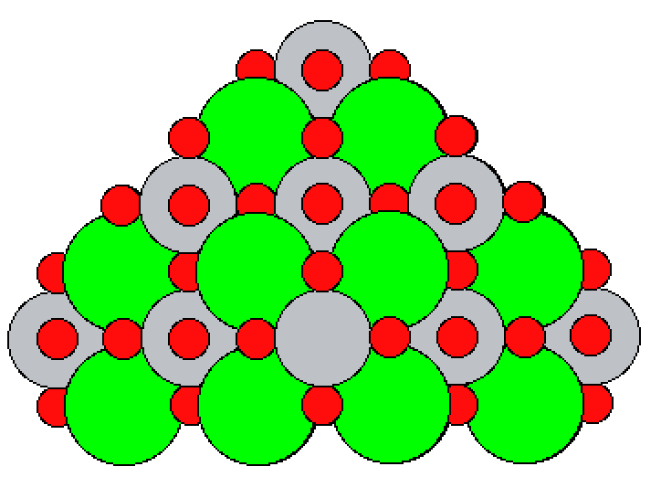
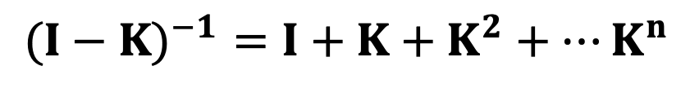
Simulation and Experiment (146atoms)
Series Expansion
$$({I−K)}^{−1}=I+{K+K}^{2}+…K^{n}$$
TiO₂
SrO
TiO₂
SrO
TiO₂
SrO
Emitter: Ti(2p_{3/2}), 1019eV
: Sr
: Ti
: O
Notes:
級数展開法を用いた、チタン酸ストロンチウムのスペクトルの解析について解説します。
First stepとして解析に用いたクラスターは、１４６原子の原子数のチタン酸ストロンチウムです。
これは、ストロンチウムと酸素の層、一つ上のチタンと酸素の層、それらが交互に積み重なった計６つの層からなります。
エミッターはTiの
右が解析結果です。実験条件はこの後説明します。
収束したスペクトルは、実験のピークをほぼ再現していますが、スペクトルの強度を見ると実験スペクトルよりも小さいです。
再び級数展開法の式について考えます。
スペクトル半径が大きくなると収束が遅くなります。どのような時に大きくなるかというと、基本的には原子数が大きくなればなるほど大きくなることが先行研究で指摘されています。
したがって、１０００原子で解析したいならば、このスペクトル半径を小さくすることが必要であると言える。ただ、チタン酸ストロンチウムで１０００原子必要なのか、必要だとしてスペクトルの収束が見られないのかはわからない。
まず、１００原子程度のチタン酸ストロンチウムクラスターに対するスペクトルと実験結果の比較を示します。
スペクトルの形を見ると、０°付近のメインピーク、１０°〜３０°の３つのピークのうち２つが再現されています。４０°〜５０°のピークは実験スペクトルはピークが小さいですが、数値解析だと３つのピークが出ました。さらに、６０°のピークは数値解析で再現されています。
次に、スペクトルの強度を見ると、数値解析では０°ピークと比較して、１０°〜３０°のスペクトル強度が実験よりも相対的に低く出ています。
ピークの数とスペクトル強度をより正確に再現するために、原子数のオーダーをあげます。
Ok, we need to optimise the omega parameter to avoid the divergence.
Here is the proucess.
If we have something like (1-x)-1, it is easy to expand it in series like .....
And we know that it converges when...,.
In the codes, we have similar one in a matrix form except the convergence where the largest eigenvalue in the modulus <1.
We call it spectral radius which is ρ.
But All eigenvalues are calculated to get spectral radius so the calculation is as heavy as the MI.
For example, it takes about 3 weeks for 1000 atoms.
And in this expansion, if we increase the order of the expansion by 1, the CPU time is multiplied by 1000 in the case where we have 1000 atoms.
We have discovered that the divergence comes from atomic chains, which are easier to analyse than large clusters.

Slide 7
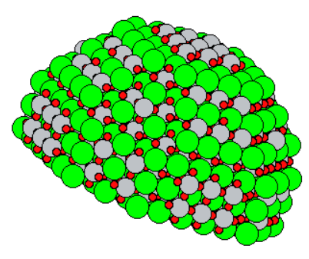
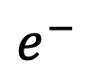

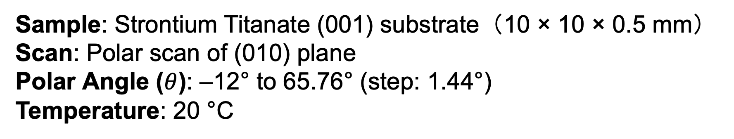
Simulating clusters: Strontium Titanate
STO cluster with emitter Ti_{2p3/2} 1019 eV
X-ray
z
$$e^{−}$$
(010) plane
$$θ$$
Number of planes: 12 (Emitter Ti in the center of each plane)
Radius of the hemisphere: 19.525 Å
Only photoelectron scattered forward is taken into account in calculation.
CPU: Apple M4, 10コア
: Sr
: Ti
: O
y
x
1920 atoms
Experimental conditions:
Sample: Strontium Titanate (001) substrate（10 × 10 × 0.5 mm） Scan: Polar scan of (010) plane Polar Angle ($θ$): –12° to 65.76° (step: 1.44°) Temperature: 20 °C
Notes:
原子数を増やしたクラスターに対する解析方法と実験条件について解説します。
解析に用いたクラスターは左図のhemishpereを用いてk採石しました。原始数は１９２０個です。層の数は１２個、hemispherの半径は１９.５２５Åです。

Slide 8
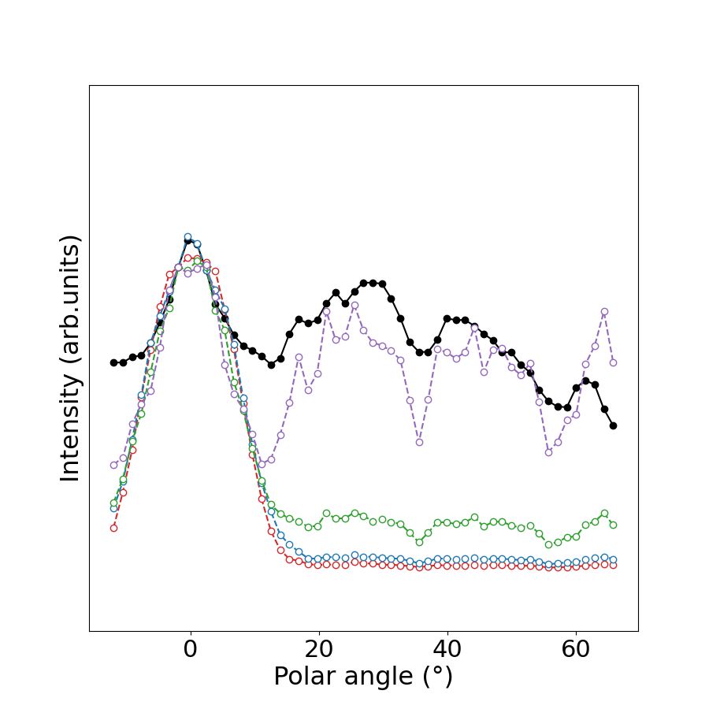
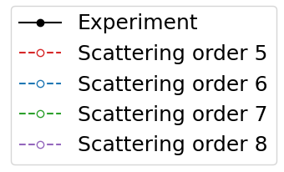
Simulation and Experiment (1920atoms)
Computational time:
Order5: 6 mins
Order6: 7 mins
Order7: 40 mins
Order8: 17 hours
Scattering order 8
Experiment
Scattering order 7
Scattering order 6
Scattering order 5
Notes:
解析結果について説明します。
黒が実験スペクトルで、散乱回数５、６、７、８で計算したものを示しています。散乱回数で８でスペクトルが収束を見せており、実験スペクトルのピークをよく再現していることがわかります。収束したスペクトルで議論したいのですが散乱回数を増やすごとに計算時間が増えていくため、今回の計算資源では現実的ではないです。

Slide 9
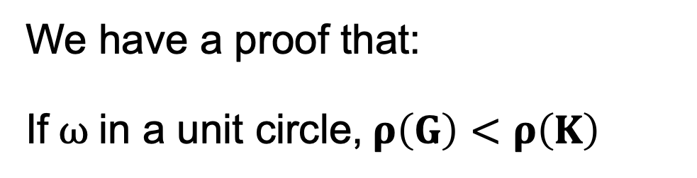

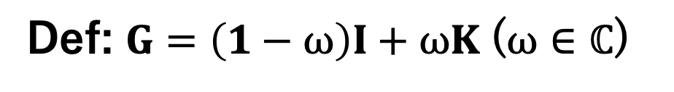
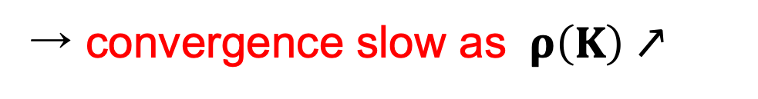
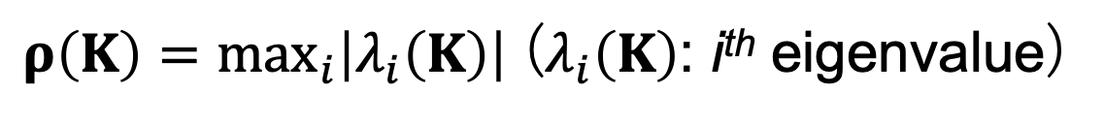

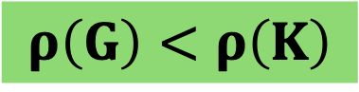

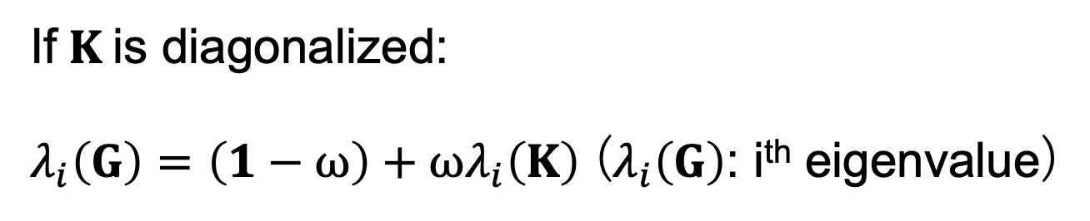
Renormalized Expansion
Series Expansion
$({I−K)}^{−1}=I+{K+K}^{2}+…K^{n}$ (n: scattering order)
→ convergence slow as $ρ\left(K\right)↗$
$ρ\left(K\right)=\max_{i}\left|λ_{i}\left(K\right)\right|$ ($λ_{i}\left(K\right)$: i^{th} eigenvalue)
Renormalized Expansion [3]
Def: $G=\left(1−ω\right)I+ωK$($ω∈ℂ$)
We have a proof that:
If $ω$ in a unit circle,$ρ\left(G\right)<ρ\left(K\right)$
$({I−K)}^{−1}=ω({I−G)}^{−1}=ω(I+{G+G}^{2}+…+G^{n})$
$$ρ\left(G\right)<ρ\left(K\right)$$
If $K$is diagonalized:
$λ_{i}\left(G\right)=$ $\left(1−ω\right)+ωλ_{i}\left(K\right)$ ($λ_{i}\left(G\right)$: i^{th} eigenvalue)
→ For a small Cu(111) cluster, this has been checked numerically [3].
$ω$optimization is as heavy as Matrix Inversion.
e.g. for 1000 atoms, around 3 weeks !
→ Any approximation is required.
[3] Takatsu, A. et al., Phys. Chem. Chem. 24 5658–5668 (2022).
Notes:
そこで、より少ない散乱回数で収束を得られる方法を考えます。
Ok, we need to optimise the omega parameter to avoid the divergence.
Here is the proucess.
If we have something like (1-x)-1, it is easy to expand it in series like .....
And we know that it converges when...,.
In the codes, we have similar one in a matrix form except the convergence where the largest eigenvalue in the modulus <1.
We call it spectral radius which is ρ.
But All eigenvalues are calculated to get spectral radius so the calculation is as heavy as the MI.
For example, it takes about 3 weeks for 1000 atoms.
And in this expansion, if we increase the order of the expansion by 1, the CPU time is multiplied by 1000 in the case where we have 1000 atoms.
We have discovered that the divergence comes from atomic chains, which are easier to analyse than large clusters.

Slide 10
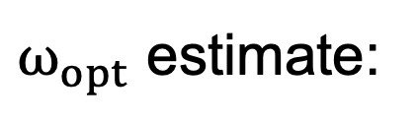
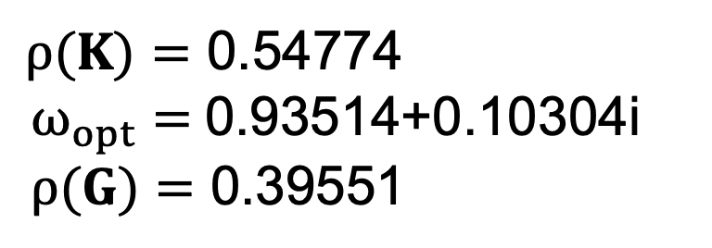
Simulating clusters: Strontium Titanate
STO cluster with Ti emitter
X-ray
z
$ω_{opt}$ estimate:
: Sr
: Ti
: O
O
Ti
z
dense atomic chain (6Ti-6O) along z-axis:
y
$ρ(K)=$ 0.54774
$ω_{opt}=$ 0.93514+0.10304i
$ρ(G)=$ 0.39551
Ti Emitter
x
1920 atoms
number of planes: 12 (Emitter Ti in the center of each plane)
radius of the hemisphere: 19.525 Å
only photoelectron scattered forward is taken into account in calculation
Notes:
本研究では、オメガを近似する方法として、１次元の原子鎖を考えます。

Slide 11
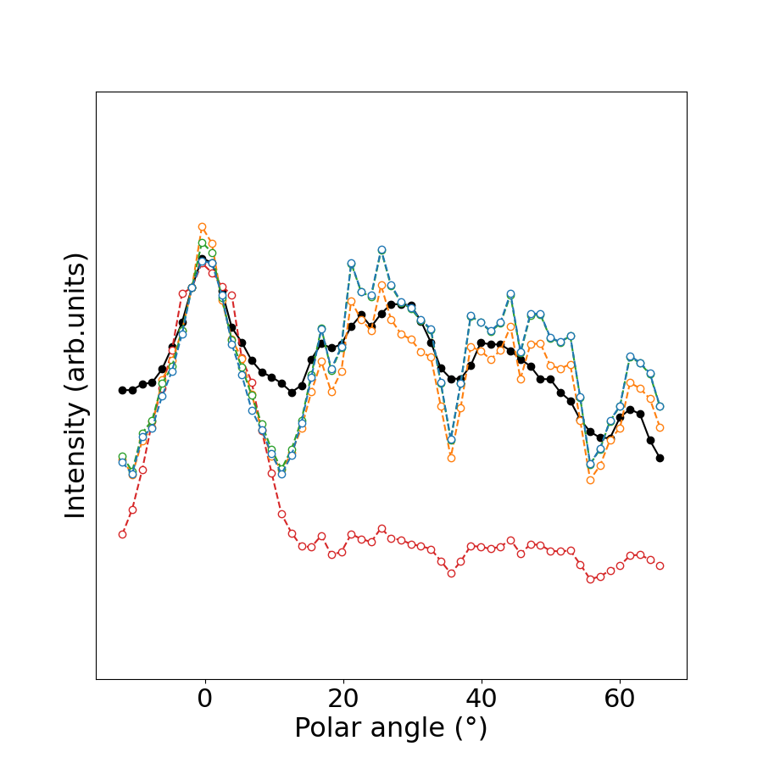
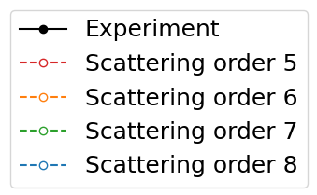
Simulation and Experiment
Renormalized
Computational time:
Order5: 6 mins
Order6: 7 mins
Order7: 40 mins
Order8: 17 hours
Scattering order 7, 8
Scattering order 6
Experiment
Scattering order 5

Slide 12
Conclusions and Future Work
Summary:
We saw the convergence of renormalized series expansion for large size clusters.
Most of the peak positions of the spectra were reproduced by 146 atoms, but the peak intensity was not.
→ Good agreement with the experiment by 1920 atoms.
Future work:
We will try to see the tiny structural changes of Strontium Titanate.
More perovskites (e.g., BrTiO₃) should be investigated in high energy region（Experimental data are available.）.
Sr
Ti
Polarization
O

Slide 13
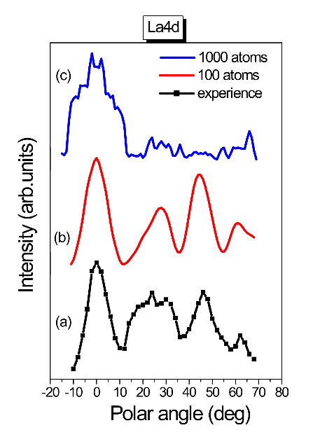
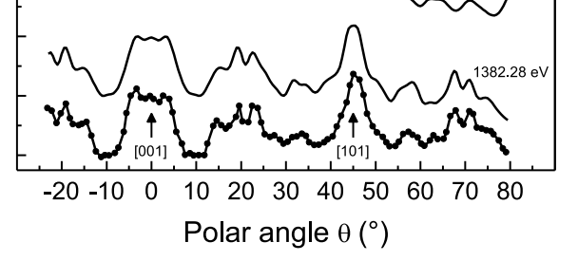

Series Expansion - Si vs LAO (LaAlO3) ⁻
Si(2p) in Si(001) substrate
La(4d) in LaAlO₃
Peaks of intensity along dense atomic directions
Polar scan of Si(2p) in Si(001) substrate
X-ray
Surface
[001]
[101]
Main peaks corresponding to dense atomic directions well reproduced
[2] S. Tricot, T. Jaouen, D. Sébilleau, P. Schieffer, J. Electron. Spectrosc., 256, 147176 (2022) .
Fig. 2: PED calculation for LaAlO₃ (Mohamed Zanouni, Faculty of Sciences, Tangiers, Morocco)
how to cure it ?
Notes:
級数展開法が成功している例を紹介させてください。
ランタンアルミネート
１００原子では、実験を完全には説明できないスペクトルになります。
１０００原子だと、実験を説明できないスペクトルが広いシータで見られます。
これは、
Series expansion
について話す。うまくいかないケースがあると This is an example of the comparison.
On the left we have polar scans of the silicon 001 substrate.
The thick line is from an experiment so we have the main peaks corresponding to dense atomic directions.
And the smooth one is simulation.
Obviously we have excellent agreement between them.
On the other hand, we have a problem with the Lanthanum Alminum Oxygen. This is one of the perovskites.
Here the black line is an experiment and the red one is a simulation with 100 atoms.
In red we have almost a good fit to the experiment, but we are missing fine peaks in black.
So when we go to 1000 atoms in blue, some unwanted peaks appear.
We call these peaks divergences.
So now the question is "where does divergence come from and how can we cure it?

Slide 14
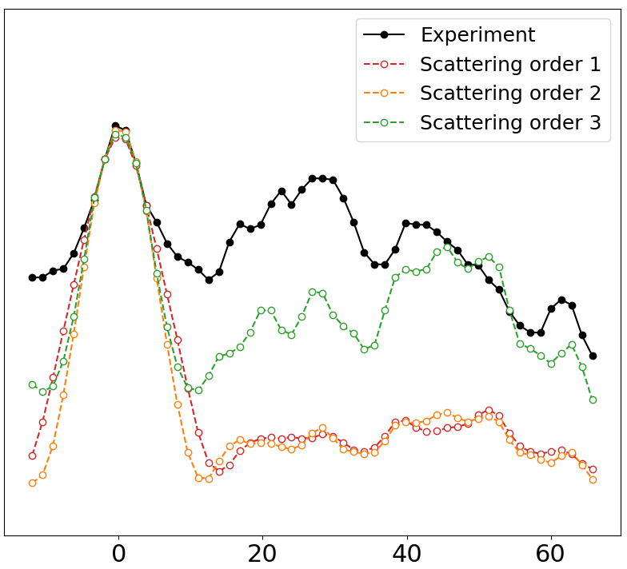
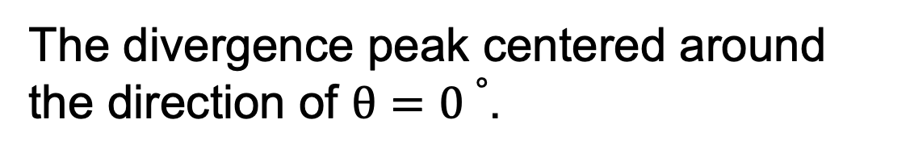
Origin of no convergence
z
O
Ti
Sr
Sr
Sr
O
Sr
y
Ti
O
O
x
The divergence peak centered around the direction of $θ=0∘$.
One dense atomic direction along z-axis (with high photoelectron intensity)
The photoelectron is scattered strongly towards dense atomic directions.
In high energy region, forward scattering is dominant.
Notes:
青
ピーク位置をよりみてる
近いと区別つかない
Ok, we need to optimise the omega parameter to avoid the divergence.
Here is the process.
If we have something like (1-x)-1, it is easy to expand it in series like .....
And we know that it converges when...,.
In the codes, we have similar one in a matrix form except the convergence where the largest eigenvalue in the modulus <1.
We call it spectral radius which is ρ.
But All eigenvalues are calculated to get spectral radius so the calculation is as heavy as the MI.
For example, it takes about 3 weeks for 1000 atoms.
And in this expansion, if we increase the order of the expansion by 1, the CPU time is multiplied by 1000 in the case where we have 1000 atoms.
We have discovered that the divergence comes from atomic chains, which are easier to analyse than large clusters.

Slide 15

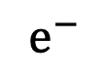
Number of scattering paths in Series Expansion
X-ray
$$e^{−}$$
Detector
Surface
Primary wave $Ψ_{0}$
The number of paths grows as ${(Nat−1)}^{Nscat}$（ $Nat$: Number of atoms, $Nscat$: Scattering order）
The photoelectron is scattered strongly towards dense atomic directions.
In high energy region, forward scattering is dominant.
Notes:
Detector
We need to understand the principle of XPD.
When the sample is rotated along the normal to the surface, we talk about an azimuthal spectrum and otherwise of a polar spectrum.
In the following, we will only deal with polar spectra.
Didier: The photoelectron gathers crystallographic information by repeated scatterings with atoms along its way out.

Slide 16
Forward Filtering in Series Expansion
X-ray
$$e^{−}$$
Detector
Surface
Primary wave $Ψ_{0}$
Forward filtering reduces the number of paths.
Forward filtering allows us to increase the scattering order.
:forward cone
Notes:
Detector
We need to understand the principle of XPD.
When the sample is rotated along the normal to the surface, we talk about an azimuthal spectrum and otherwise of a polar spectrum.
In the following, we will only deal with polar spectra.
Didier: The photoelectron gathers crystallographic information by repeated scatterings with atoms along its way out.

Slide 17
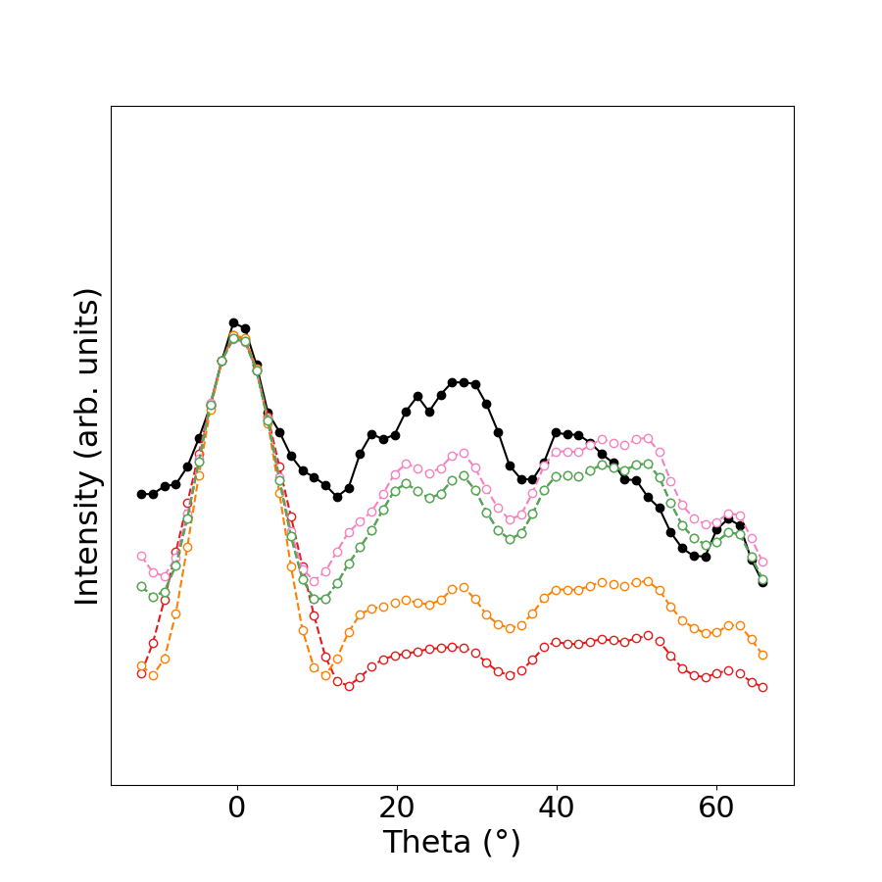
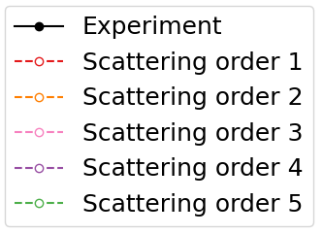
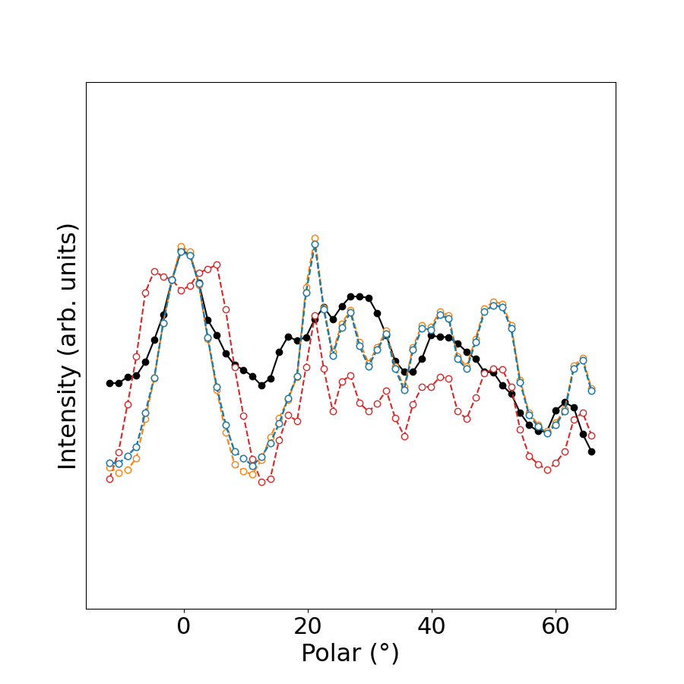
Forward Filtering 0°(146 atoms)
Ti(2p3/2) 1019 eV
Notes:
Ok, we need to optimise the omega parameter to avoid the divergence.
Here is the process.
If we have something like (1-x)-1, it is easy to expand it in series like .....
And we know that it converges when...,.
In the codes, we have similar one in a matrix form except the convergence where the largest eigenvalue in the modulus <1.
We call it spectral radius which is ρ.
But All eigenvalues are calculated to get spectral radius so the calculation is as heavy as the MI.
For example, it takes about 3 weeks for 1000 atoms.
And in this expansion, if we increase the order of the expansion by 1, the CPU time is multiplied by 1000 in the case where we have 1000 atoms.
We have discovered that the divergence comes from atomic chains, which are easier to analyse than large clusters.

Slide 18


Forward Filtering 0°(400 atoms)
Ti(2p_{3/2}) 1019 eV
Notes:
Ok, we need to optimise the omega parameter to avoid the divergence.
Here is the process.
If we have something like (1-x)-1, it is easy to expand it in series like .....
And we know that it converges when...,.
In the codes, we have similar one in a matrix form except the convergence where the largest eigenvalue in the modulus <1.
We call it spectral radius which is ρ.
But All eigenvalues are calculated to get spectral radius so the calculation is as heavy as the MI.
For example, it takes about 3 weeks for 1000 atoms.
And in this expansion, if we increase the order of the expansion by 1, the CPU time is multiplied by 1000 in the case where we have 1000 atoms.
We have discovered that the divergence comes from atomic chains, which are easier to analyse than large clusters.

Slide 19


Forward Filtering 0°(400 atoms)
Ti(2p3/2) 1019 eV

Slide 20






Cluster planes
1920atoms
1830atoms
1612atoms
1286atoms
884atoms
446atoms
Notes:
Ok, we need to optimise the omega parameter to avoid the divergence.
Here is the process.
If we have something like (1-x)-1, it is easy to expand it in series like .....
And we know that it converges when...,.
In the codes, we have similar one in a matrix form except the convergence where the largest eigenvalue in the modulus <1.
We call it spectral radius which is ρ.
But All eigenvalues are calculated to get spectral radius so the calculation is as heavy as the MI.
For example, it takes about 3 weeks for 1000 atoms.
And in this expansion, if we increase the order of the expansion by 1, the CPU time is multiplied by 1000 in the case where we have 1000 atoms.
We have discovered that the divergence comes from atomic chains, which are easier to analyse than large clusters.

Slide 21


Simulation and Experiment – all planes -
Ti(2p_{3/2}) 1019 eV
Notes:
Ok, we need to optimise the omega parameter to avoid the divergence.
Here is the process.
If we have something like (1-x)-1, it is easy to expand it in series like .....
And we know that it converges when...,.
In the codes, we have similar one in a matrix form except the convergence where the largest eigenvalue in the modulus <1.
We call it spectral radius which is ρ.
But All eigenvalues are calculated to get spectral radius so the calculation is as heavy as the MI.
For example, it takes about 3 weeks for 1000 atoms.
And in this expansion, if we increase the order of the expansion by 1, the CPU time is multiplied by 1000 in the case where we have 1000 atoms.
We have discovered that the divergence comes from atomic chains, which are easier to analyse than large clusters.

Slide 22


Simulation and Experiment – plane 0 ~ 2 -
Ti(2p_{3/2}) 1019 eV
Notes:
Ok, we need to optimise the omega parameter to avoid the divergence.
Here is the process.
If we have something like (1-x)-1, it is easy to expand it in series like .....
And we know that it converges when...,.
In the codes, we have similar one in a matrix form except the convergence where the largest eigenvalue in the modulus <1.
We call it spectral radius which is ρ.
But All eigenvalues are calculated to get spectral radius so the calculation is as heavy as the MI.
For example, it takes about 3 weeks for 1000 atoms.
And in this expansion, if we increase the order of the expansion by 1, the CPU time is multiplied by 1000 in the case where we have 1000 atoms.
We have discovered that the divergence comes from atomic chains, which are easier to analyse than large clusters.

Slide 23


Forward Filtering 30°(1920atoms)
Ti(2p_{3/2}) 1019 eV
Notes:
Ok, we need to optimise the omega parameter to avoid the divergence.
Here is the process.
If we have something like (1-x)-1, it is easy to expand it in series like .....
And we know that it converges when...,.
In the codes, we have similar one in a matrix form except the convergence where the largest eigenvalue in the modulus <1.
We call it spectral radius which is ρ.
But All eigenvalues are calculated to get spectral radius so the calculation is as heavy as the MI.
For example, it takes about 3 weeks for 1000 atoms.
And in this expansion, if we increase the order of the expansion by 1, the CPU time is multiplied by 1000 in the case where we have 1000 atoms.
We have discovered that the divergence comes from atomic chains, which are easier to analyse than large clusters.

Slide 24


Forward Filtering 20°(1920atoms)
Ti(2p_{3/2}) 1019 eV
Notes:
Ok, we need to optimise the omega parameter to avoid the divergence.
Here is the process.
If we have something like (1-x)-1, it is easy to expand it in series like .....
And we know that it converges when...,.
In the codes, we have similar one in a matrix form except the convergence where the largest eigenvalue in the modulus <1.
We call it spectral radius which is ρ.
But All eigenvalues are calculated to get spectral radius so the calculation is as heavy as the MI.
For example, it takes about 3 weeks for 1000 atoms.
And in this expansion, if we increase the order of the expansion by 1, the CPU time is multiplied by 1000 in the case where we have 1000 atoms.
We have discovered that the divergence comes from atomic chains, which are easier to analyse than large clusters.

Slide 25


Forward Filtering 10°(1920atoms)
Ti(2p_{3/2}) 1019 eV
Notes:
Ok, we need to optimise the omega parameter to avoid the divergence.
Here is the process.
If we have something like (1-x)-1, it is easy to expand it in series like .....
And we know that it converges when...,.
In the codes, we have similar one in a matrix form except the convergence where the largest eigenvalue in the modulus <1.
We call it spectral radius which is ρ.
But All eigenvalues are calculated to get spectral radius so the calculation is as heavy as the MI.
For example, it takes about 3 weeks for 1000 atoms.
And in this expansion, if we increase the order of the expansion by 1, the CPU time is multiplied by 1000 in the case where we have 1000 atoms.
We have discovered that the divergence comes from atomic chains, which are easier to analyse than large clusters.

Slide 26


Forward Filtering 0°(1920atoms)
Ti(2p_{3/2}) 1019 eV
Notes:
Ok, we need to optimise the omega parameter to avoid the divergence.
Here is the process.
If we have something like (1-x)-1, it is easy to expand it in series like .....
And we know that it converges when...,.
In the codes, we have similar one in a matrix form except the convergence where the largest eigenvalue in the modulus <1.
We call it spectral radius which is ρ.
But All eigenvalues are calculated to get spectral radius so the calculation is as heavy as the MI.
For example, it takes about 3 weeks for 1000 atoms.
And in this expansion, if we increase the order of the expansion by 1, the CPU time is multiplied by 1000 in the case where we have 1000 atoms.
We have discovered that the divergence comes from atomic chains, which are easier to analyse than large clusters.

Slide 27


Computational time of Series Expansion
$$e^{−}$$
We have a rough estimate of the computational time of cross section:
(Calculation time) ∝(Number of paths)
Number of times vs Scattering order（5 atoms）

Slide 28




Path Filtering in Series Expansion
Forward or Backward Filtering applicable in Series and Renormalized Expansions:
:forward cone
$$e^{−}$$
:backward cone
$$e^{−}$$
Forward Filtering
Backward Filtering
Forward filtering reduces the number of paths.
Forward filtering allows us to increase the scattering order.

Slide 29








Damping effects
$$\frac{dσ}{d\hat{k}}=8π^{2}αk\frac{mω_{q}}{ℏ}\sum_{0}{\sum_{m_{c}}{{\left|\sum_{L0}{M_{L0Lc}^{00}{\sum_{j,Lj}{{\tilde{τ}}_{LjL0}^{j0}Y_{Lj}(\hat{k})}e}^{−i\vec{k}∙\vec{R}j}}\right|}^{2}}}$$
For a fixed emitter and core azimuthal quantum number, divide the sum over j as follows…
$$\frac{dσ}{d\hat{k}}=8π^{2}αk\frac{mω_{q}}{ℏ}{\left|\sum_{L0}{M_{L0Lc}^{00}}\sum_{Lj}{T_{LjL0}^{00}}Y_{Lj}\left(\hat{k}\right)+\sum_{L0}{M_{L0Lc}^{00}}\sum_{j≠0,Lj}{{\tilde{τ}}_{LjL0}^{j0}Y_{Lj}(\hat{k})}\right|}^{2}$$
$$f_{0}(\hat{k})$$
$$f_{1}(\hat{k})$$
$$\frac{dσ}{d\hat{k}}=8π^{2}αk\frac{mω_{q}}{ℏ}{\left|f_{0}(\hat{k})+\sum_{j≠0}{f_{j}(\hat{k})}\right|}^{2}$$
$$\hat{k}$$
$$\hat{k}$$
$$e^{−}$$
No scattering information
Multiple scattering information
atom 0（emitter）
atom 1

Slide 30








Damping effects: Surface and vibration
$$\frac{dσ}{d\hat{k}}=8π^{2}αk\frac{mω_{q}}{ℏ}{\left|f_{d}(\hat{k})+\sum_{j≠0}{f_{j}(\hat{k})}\right|}^{2}$$
Surface attenuation:
$$θ_{j}^{g}$$
$$e^{−γ\frac{d_{j} }{cosθ_{j}^{g}}}$$
$(γ$: attenuation coefficient$)$
$$d_{j}^{′}$$
$$d_{j}$$
$$d_{j}$$
Vibrational dumping:
$$e^{−ik^{2}{\left\langle u_{j}\right\rangle }^{2}(1−cosθ_{j}^{T} )}$$
$$θ_{j}^{T}$$
Debye Waller Factor

Slide 31


Damping effects: Debye-Waller Factor
$$\frac{dσ}{d\hat{k}}=8π^{2}αk\frac{mω_{q}}{ℏ}{\left|\sum_{j}{f_{j}(\hat{k})}e^{−γ\frac{d_{j} }{cosθ_{j}^{g}}}e^{−ik^{2}{\left\langle u_{j}\right\rangle }^{2}(1−cosθ_{j}^{T} )}\right|}^{2}$$
Ti2p3/2（1019 eV）
Debye Waller Factor does not explain suppression of photoelectron intensity towards dense atomic direction.

Slide 32







Damping effects: Surface: Averaged $T_{l}$
$$\frac{dσ}{d\hat{k}}=8π^{2}αk\frac{mω_{q}}{ℏ}{\left|\sum_{L0}{M_{L0Lc}^{00}}\sum_{Lj}{T_{LjL0}^{00}}Y_{Lj}\left(\hat{k}\right)+\sum_{L0}{M_{L0Lc}^{00}}\sum_{j≠0,L_{j}}{{\tilde{τ}}_{LjL0}^{j0}Y_{Lj}(\hat{k})}\right|}^{2}$$
$${\left[G_{0}T\right]}_{LjL0}^{j0}$$
$$\left\{\begin{aligned}G_{0} \\ T\end{aligned}\right.$$
: Free propagator
: T-matrix
Averaged $T_{l}$ [4]:
$$T_{l^{′}}=e^{−k^{2}\left\langle u^{2}\right\rangle }\sum_{l,l_{0}}{i^{−l}j_{l}(ik^{2}\left\langle u^{2}\right\rangle )(2l+1)(2l_{0}+1)\left(\begin{matrix}l_{0} & l & l^{′} \\ 0 & 0 & 0\end{matrix}\right) T_{l_{0}}^{0}}$$
${(T}_{l}=isinδ_{l}e^{iδ_{l}}$)
Spherical Bessel function
Wigner 3-j symbol
[4] Fritzsche. et al., Phys. Rev. B 49, 10643 (1994).

Slide 33



Damping effects: Surface: Averaged $T_{l}$
$$\frac{dσ}{d\hat{k}}=8π^{2}αk\frac{mω_{q}}{ℏ}{\left|\sum_{L0}{M_{L0Lc}^{00}}\sum_{Lj}{T_{LjL0}^{00}}Y_{Lj}\left(\hat{k}\right)+\sum_{L0}{M_{L0Lc}^{00}}\sum_{j≠0,L_{j}}{{\tilde{τ}}_{LjL0}^{j0}Y_{Lj}(\hat{k})}\right|}^{2}$$
Ti2p3/2（1019 eV）
Averaged T_{l} explains the suppression of the photoelectron intensity towards the dense atomic direction.

Slide 34

Success of Renormalization method
Cu(010) 50 atoms:
z
y
x

Slide 35

Renormalization method - eigenvalues -
All spectra are:
Imaginary part
Real part
Spectral radius > 1

Slide 36

Renormalization method - eigenvalues -
Renormalization:
Imaginary part
Real part
Spectral radius < 1

Slide 37








Methodology for atomic chains
Methodology: calculate ω only for dense atomic chains and then use it for the full cluster.
e.g.:
Pt
84 atoms cluster of Pt
Spectral radius = 1,09 @ 410 eV
Spectral radius follows the same trend than Perovskites
Can still be computed by MI to aid comparison
Emitter atom
G₁ order n = 9
Π₁ order n = 6
MI
Finding a good approximation of $ω_{opt}$ by working on sub-chains of atoms and applying the result to the full cluster…
Calculated $ω_{opt}$ for the [110] 5-atoms chains works also for the full cluster.
Π₁ is faster than G₁
CPU ∝(N_{at}-1)^{n}
$a_{\left[111\right]}=$ 6,79 Å
Pt
[001]
[010]
[100]
$a_{\left[110\right]}=$ 2,77 Å
$a_{\left[100\right]}=$ 3,92 Å
Polar angle (degree)
Notes:
Then we have the methodology to calculate ω only for dense atomic chains and then use it for the full cluster.
Here we tested the cluster of a 84 Pt cluster.
Photoelectron kinetic energy is 420eV not high.
But we have the spectral radius above 1 thus it shows divergence. And in this figure, the black is MI with three peaks corresponding to dense atomic chains here.
And the pink and orange are renormalizations which are G and pi by ω from [110] 5 atomic chains.
For G1 and P1, the truncation orders are important because the CPU time is propotional to…
And we see that Pi is faster than G1.
83^9, 6
It is quite early.
How about STO cluster ?
Even the monoatomic cluster had the divergence and STO is a heterostructure.

Slide 38

Creation of cluster
Recipe for creating clusters
The cluster tested is shaped like a hemisphere (right) based on a sphere.
We created a cylinder-shaped cluster with a large number of atoms, eliminated all atoms out of a sphere given a radius, and cut the part below a given z coordinate.

Slide 39
Energy level
Ti:
‘1s1/2' : 4966.
‘2s1/2': 560.9,
‘2p1/2': 460.2,
‘2p3/2': 453.8,
‘3s1/2': 58.7,
‘3p1/2': 32.6,
‘3p3/2': 32.6
Sr:
‘1s1/2' : 16105.
‘2s1/2': 2216.
‘2p1/2': 2007.
‘2p3/2': 1940.
‘3s1/2': 358.7,
‘3p1/2': 280.3,
‘3p3/2': 270.
‘3d3/2': 136.
‘3d5/2': 134.2,
‘4s1/2': 38.9,
‘4p1/2': 21.3,
‘4p3/2': 20.1
O:
'1s1/2': 543.1,
'2s1/2': 41.6
E(2p1/2)-E(2p3/2)
=6.4eV > 0.9eV

Slide 40

Computer code used: MsSpec
MsSpec [5]
- Python-Fortran combined package to compute the differential cross-section for PED
MsSpec has:
- Matrix inversion (MI): Exact solution but with memory storage requirement then almost impossible for large clusters ($>$1000 atoms)
- Series expansion (SE): perturbative solution, usually applicable for large clusters
When not applicable
Renormalization methods:
- Some renormalization methods have been proposed. [6]
- Renormalization complex parameter, ω should be optimized to use them.
[5] Website of MsSpec: https://msspec.cnrs.fr/index.html.
[6] Takatsu, A. et al., Phys. Chem. Chem. 24 5658–5668 (2022).
Notes:
To answer the questions, we are working on a specific package called MsSpec.
The matrix inversion is an exact solution in theory and should be the same as what we get from experiments.
SE: Perturbative means that it might have divergence.
On the arrow animation: When it is not applicable, we use renormalisation methods.

Slide 41


Scattering factor
Scattering amplitude, f(θ) represents an angular part of the spherically scattering wave:
Outcoming wave: Spherical
f(θ) $\frac{e^{ikz}}{r}$
$$e^{ikz}$$
z
Incoming X-ray: Plane wave
Scatterer

Slide 42



Scattering factor
Scattering factor is the largest in high energy region.
Backward
Forward

Slide 43
Atomic chains in STO[111] direction
8 Ti-Sr atomic chain at 1019eV
Ti
z
Emitter
3.382Å
Backscattering
Forward scattering
Scattering factor of Ti at 1019eV
Notes:
Let’s use it to the atomic chain of STO. Here we have a Titanium-Strontium chain with the atomic distance, 3.4 and this photoelectron kinetic energy.
And it is just a linear chain so what we consider are forward scattering and backscattering from an atom.

Slide 44
Nelder-Mead algorithm
Algorithm to find a minimum of a function
Characteristics:
1. Simplicity and wide applicability The method is conceptually simple and can be applied to a broad range of problems.
2. No gradient information required Since it does not rely on gradient information, it is well suited for non-differentiable functions.
3. Tendency to converge to local minima The algorithm often converges to local optima, and its effectiveness may be limited in large-scale or highly complex optimization problems.
4. Sensitivity to initialization and parameters The performance strongly depends on the initial simplex configuration and parameter settings, requiring careful tuning.
Notes:
Let’s use it to the atomic chain of STO. Here we have a Titanium-Strontium chain with the atomic distance, 3.4 and this photoelectron kinetic energy.
And it is just a linear chain so what we consider are forward scattering and backscattering from an atom.

Slide 45
Nelder-Mead algorithm
Im(ω)
Im(ω)
1
2
3
2
3
Center of mass of 2 and 3
Re(ω)
Re(ω)
1’
Worst vertex (highest function value) → reflection / expansion / contraction / shrinkage
Notes:
Let’s use it to the atomic chain of STO. Here we have a Titanium-Strontium chain with the atomic distance, 3.4 and this photoelectron kinetic energy.
And it is just a linear chain so what we consider are forward scattering and backscattering from an atom.

Slide 46
Nelder-Mead algorithm
Cu(010) 50 atoms:
z
y
x

Slide 47

Nelder-Mead algorithm
1.0
Imaginary part
0.0
-1.0
-1.0
0.0
1.0
2.0
Real part
Notes:
Let’s use it to the atomic chain of STO. Here we have a Titanium-Strontium chain with the atomic distance, 3.4 and this photoelectron kinetic energy.
And it is just a linear chain so what we consider are forward scattering and backscattering from an atom.

Slide 48


Experimental setup
Energy Source
The energy of X-ray source should be higher than the orbital energy
$$E_{e} = hv − E_{o} − W$$
Geometry
Cluster orientation, angles of X-ray Source, etc…
Cluster detail
Orbital energy for an emitter
Kinetic energy of $e^{−}$
Source energy
Orbital energy
Work function ~ 4 – 5 eV

Slide 49
Experimental setup - Energy Source – [6]
We have two considerations:
Line width must not limit the energy resolution
Energy must be high enough
In general, two types of materials are used for energy source, Al and Mg.
Line width less than 1.0eV
High energy
Moreover, ease of fabrication and stability under electron bombardment
Energies and widths of some characteristic soft X-ray lines (excerpted from )
Line | Energy（eV） | Width（eV）
Mg Kα | 1253.6 | 0.7
Al Kα | 1486.6 | 0.85
[6] D.Briggs and M.P.Seath PRACTICAL SURFACE ANALYSIS SECOND EDITION VOLUME 1 – Auger and X-ray- Photoelectron Spectroscopy (1990) (p51 - 54).

Slide 50

Experimental setup - Energy Source [6]
Two thin films are deposited on Cu anode (10μm in typical).
Both are switched simply, in a couple of minutes.
Two cathodes eject electrons into the anode nearby.
Water flowing inside the anode to cool it under the electron bombardment.
X-ray passes out through Al window.
screen the sample from stray electrons
heating effects
contamination in the source
Twin X-ray anode sources
[6] D.Briggs and M.P.Seath PRACTICAL SURFACE ANALYSIS SECOND EDITION VOLUME 1 – Auger and X-ray- Photoelectron Spectroscopy (1990) (p54 - 56).

Slide 51


Omicron EA125 hemispherical analyser
Detector angular acceptance: $±1°$
Energy resolution: Better than 0.9eV

Slide 52

Experimental setup - Geometry -
Omicron EA125
hemispherical analyser
Analyzer
X-ray tube

Slide 53

Experimental setup - Geometry -
Zoom
Polar scan from
-10°~ 60°
(less than -10°,the sample would hit the X-ray source)

Slide 54
Experimental setup - Geometry -
z
^{Experimental setup:}
y
α
x (Analizer)
β
・Analizer axis is normal to the surface and fixed during the experiment.
・Angle between the analyser axis and x-ray axis = β = 55.15°(α = -44.7°)

Slide 55
Experimental setup - Geometry -
z (Analizer)
Experimental setup: Experiment and numeral setups, consistency
β
α
y
α
α
β
x
x (Analizer)
Angles:
α = -44.7°
β = 55.15°
Angles:
α = -44.7°
β = 55.15°

Slide 56
Experimental setup
The surface is preferred to be TiO₂ side.
TiO₂
SrO
Oxidized SrO surface:
SrO → Sr(OH)2
+carbon contaminate
The effect is tiny…
SrO
Sr: 3d5/2 (1344.5 eV), 3d3/2 (1344.5+1.74 eV)
Ti: 2p3/2 (1018.8eV)
O: 1s (947.6eV)

Slide 57




^{Origin of divergence}
We expect that:
z
$$ρ\left(G\right)<1$$
O
Ti
Sr
Sr
Sr
O
Sr
y
Ti
O
O
x
The divergence peak centered around the direction of $Theta=0∘$.
One dense atomic direction along z-axis (with high photoelectron intensity)
Hypothesis: The atomic chain (Ti-O-Ti-O-…) is responsible for this divergence and has a good approximation of $ω_{opt}$ for the whole cluster.
Notes:
Ok, we need to optimise the omega parameter to avoid the divergence.
Here is the process.
If we have something like (1-x)-1, it is easy to expand it in series like .....
And we know that it converges when...,.
In the codes, we have similar one in a matrix form except the convergence where the largest eigenvalue in the modulus <1.
We call it spectral radius which is ρ.
But All eigenvalues are calculated to get spectral radius so the calculation is as heavy as the MI.
For example, it takes about 3 weeks for 1000 atoms.
And in this expansion, if we increase the order of the expansion by 1, the CPU time is multiplied by 1000 in the case where we have 1000 atoms.
We have discovered that the divergence comes from atomic chains, which are easier to analyse than large clusters.

Slide 58
Success and failure of Series Expansion - Si vs LAO (LaAlO3⁾ ⁻
Si(2p) in Si(001) substrate
La(4d) in LaAlO₃
Peaks of intensity along dense atomic directions
Polar scan of Si(2p) in Si(001) substrate
X-ray
Surface
[001]
[101]
Main peaks corresponding to dense atomic directions well reproduced
[2] S. Tricot, T. Jaouen, D. Sébilleau, P. Schieffer, J. Electron. Spectrosc., 256, 147176 (2022) .
Fig. 2: PED calculation for LaAlO₃ (Mohamed Zanouni, Faculty of Sciences, Tangiers, Morocco)
Where divergence comes from and how to cure it ?
Notes:
Series expansion
について話す。うまくいかないケースがあると This is an example of the comparison.
On the left we have polar scans of the silicon 001 substrate.
The thick line is from an experiment so we have the main peaks corresponding to dense atomic directions.
And the smooth one is simulation.
Obviously we have excellent agreement between them.
On the other hand, we have a problem with the Lanthanum Alminum Oxygen. This is one of the perovskites.
Here the black line is an experiment and the red one is a simulation with 100 atoms.
In red we have almost a good fit to the experiment, but we are missing fine peaks in black.
So when we go to 1000 atoms in blue, some unwanted peaks appear.
We call these peaks divergences.
So now the question is "where does divergence come from and how can we cure it?

Slide 59


^{Origin of divergence}
Notes:
Ok, we need to optimise the omega parameter to avoid the divergence.
Here is the process.
If we have something like (1-x)-1, it is easy to expand it in series like .....
And we know that it converges when...,.
In the codes, we have similar one in a matrix form except the convergence where the largest eigenvalue in the modulus <1.
We call it spectral radius which is ρ.
But All eigenvalues are calculated to get spectral radius so the calculation is as heavy as the MI.
For example, it takes about 3 weeks for 1000 atoms.
And in this expansion, if we increase the order of the expansion by 1, the CPU time is multiplied by 1000 in the case where we have 1000 atoms.
We have discovered that the divergence comes from atomic chains, which are easier to analyse than large clusters.

Slide 60
^{Origin of divergence}
Notes:
Ok, we need to optimise the omega parameter to avoid the divergence.
Here is the process.
If we have something like (1-x)-1, it is easy to expand it in series like .....
And we know that it converges when...,.
In the codes, we have similar one in a matrix form except the convergence where the largest eigenvalue in the modulus <1.
We call it spectral radius which is ρ.
But All eigenvalues are calculated to get spectral radius so the calculation is as heavy as the MI.
For example, it takes about 3 weeks for 1000 atoms.
And in this expansion, if we increase the order of the expansion by 1, the CPU time is multiplied by 1000 in the case where we have 1000 atoms.
We have discovered that the divergence comes from atomic chains, which are easier to analyse than large clusters.

Slide 61


^{Origin of divergence}
Notes:
Ok, we need to optimise the omega parameter to avoid the divergence.
Here is the process.
If we have something like (1-x)-1, it is easy to expand it in series like .....
And we know that it converges when...,.
In the codes, we have similar one in a matrix form except the convergence where the largest eigenvalue in the modulus <1.
We call it spectral radius which is ρ.
But All eigenvalues are calculated to get spectral radius so the calculation is as heavy as the MI.
For example, it takes about 3 weeks for 1000 atoms.
And in this expansion, if we increase the order of the expansion by 1, the CPU time is multiplied by 1000 in the case where we have 1000 atoms.
We have discovered that the divergence comes from atomic chains, which are easier to analyse than large clusters.

Slide 62


^{Origin of divergence}
Notes:
Ok, we need to optimise the omega parameter to avoid the divergence.
Here is the process.
If we have something like (1-x)-1, it is easy to expand it in series like .....
And we know that it converges when...,.
In the codes, we have similar one in a matrix form except the convergence where the largest eigenvalue in the modulus <1.
We call it spectral radius which is ρ.
But All eigenvalues are calculated to get spectral radius so the calculation is as heavy as the MI.
For example, it takes about 3 weeks for 1000 atoms.
And in this expansion, if we increase the order of the expansion by 1, the CPU time is multiplied by 1000 in the case where we have 1000 atoms.
We have discovered that the divergence comes from atomic chains, which are easier to analyse than large clusters.

Slide 63


^{Origin of divergence}
Notes:
Ok, we need to optimise the omega parameter to avoid the divergence.
Here is the process.
If we have something like (1-x)-1, it is easy to expand it in series like .....
And we know that it converges when...,.
In the codes, we have similar one in a matrix form except the convergence where the largest eigenvalue in the modulus <1.
We call it spectral radius which is ρ.
But All eigenvalues are calculated to get spectral radius so the calculation is as heavy as the MI.
For example, it takes about 3 weeks for 1000 atoms.
And in this expansion, if we increase the order of the expansion by 1, the CPU time is multiplied by 1000 in the case where we have 1000 atoms.
We have discovered that the divergence comes from atomic chains, which are easier to analyse than large clusters.

Slide 64
Path Filtering in Series Expansion
Forward or Backward Filtering applicable in Series and Renormalized Expansions:
:forward cone
$$e^{−}$$
:forward cone
$$e^{−}$$
Forward Filtering
Backward Filtering
Forward filtering reduces the number of paths.
Forward filtering allows us to increase the scattering order.

Slide 65

Perovskite material: Strontium Titanate (SrTiO3)
Technological importance (Resistance switching, Blue-light emission, Photo-catalysis, 2DEG…)
Small changes in structure responsible for essential properties in perovskites
SrTiO3 unit cell
e.g. 2-dimensional electron gas formation
Sr
Ti
O
Atomic structure and (b) the CB/VB profiles along [001] of 8-u.c.-thick LAO (001) grown on 12-u.c.-thick STO [1].
3,905 Å
To understand and/or control these properties, we need:
✓ Surface sensitivity
[1] I.V. Maznichenko. et al., Phys. Rev. Mater. 3, 074006 (2019).
Notes:
タイトル、６０
化学
仮数、
polar discontinuity
alternately charged planes [LaO]+and[AlO2]−
AttheTiO2/LaO-terminated LAO/STO interface,therefore, each interfacial La transfers half of an electron intothe neighboring and formally neutral TiO2layer that decreasesthe oxidation state of interfacial Ti
All epitaxially grown perovskite heterostructures containintrinsic oxygen vacancies and substitutional cations near theinterfaces [14,15]. Interfacial defects may induce additionalcharged carriers
So as in the topic.
We are interested in the perovskites esp, Strontium Titanium Oxygen, or STO, because small changes in its structure are responsible for essential properties.
And it is of great technological importance.
The unit cell is a face-centred one, where we have 8 Srs at each vortex, 6 Oxygen at each centre of the faces and 1 Titanium in the centre.
Here is an example of 2-dimensional electron gas formation.
Firstly, on the left we have the iron and the STO layer and interface.
Secondly, oxygen migrates to the iron layer and we have oxidised irons and oxygen vacancies.
And if you look at the unit cell on the right, we have an oxygen vacancy and it causes the titanium to deviate upwards.
However, to understand and control such a property we need accurate crystallographic information, chemical resolution and surface sensitivity and the best way to do that is with X-ray photoelectron diffraction, called XPD.

Slide 66
Ti:
'k' : 4966.
'l1': 560.9,
'l2': 460.2,
'l3': 453.8,
'm1': 58.7,
'm2': 32.6,
'm3': 32.6
Sr:
'k' : 16105.
'l1': 2216.
'l2': 2007.
'l3': 1940.
'm1': 358.7,
'm2': 280.3,
'm3': 270.
'm4': 136.
'm5': 134.2,
'n1': 38.9,
'n2': 21.3,
'n3': 20.1}
Sr:
‘1s1/2' : 16105.
‘2s1/2': 2216.
‘2p1/2': 2007.
‘2p3/2': 1940.
‘3s1/2': 358.7,
‘3p1/2': 280.3,
‘3p3/2': 270.
‘3d3/2': 136.
‘3d5/2': 134.2,
‘4s1/2': 38.9,
‘4p1/2': 21.3,
‘4p3/2': 20.1
Ti:
‘1s1/2' : 4966.
‘2s1/2': 560.9,
‘2p1/2': 460.2,
‘2p3/2': 453.8,
‘3s1/2': 58.7,
‘3p1/2': 32.6,
‘3p3/2': 32.6
O:
'k' : 543.1 'l1': 41.6
O:
'1s1/2': 543.1,
'2s1/2': 41.6

